Slide 1

User Churn Analysis
EDA and Machine Learning Modelling

Slide 2
PROJECT OVERVIEW and GOALS
Waze leadership has asked the data team to build a machine learning model to predict user churn. The model is based on data collected from users of the Waze app.
We will achieve this through a series of milestones:
EDA and Data Visualizations
Computing descriptive statistics and conducting hypothesis testing
Building a regression model(for comparison) and evaluating that model
Building a machine learning model
Based on the data, communicate final insights and any recommendations

Slide 3
Methodology and Technology
Data Sources:
Waze User Data(one-month) via waze_dataset.csv
Data Cleaning:
Dataset was cleaned using Python pandas and numpy
Exploratory Data Analysis:
EDA performed using Python pandas, numpy, pyplot, and seaborn
Hypothesis Testing:
Hypothesis testing performed with Python pandas and scipy stats
Model Building and Evaluation:
Models built using Python sklearn.linear_model, RandomForestClassifier, XGBClassifier

Slide 4
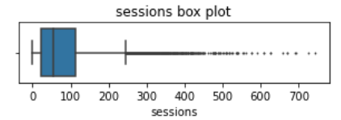
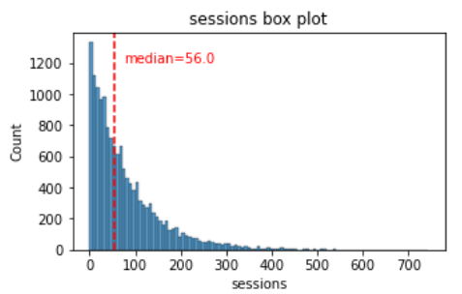
Sessions
The boxplot reveals that a subset of users has more than 700 sessions.
The median number of session is 56.
The sessions variable exhibits a skewed distribution to the right, where approximately 50% of the observations consist of 56 sessions or fewer.

Slide 5
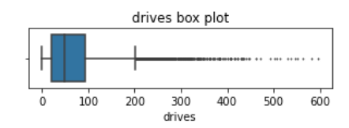
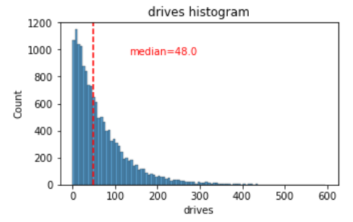
Drives
The drives data exhibits a distribution resembling that of the ‘sessions’ variable.
It is right-skewed, resembles a log-normal distribution, with a median of 48 drives.
However, a subset of drivers recorded over 400 drives in the last month.

Slide 6
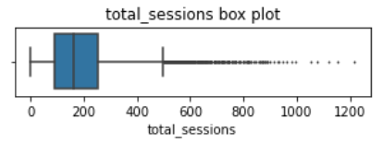
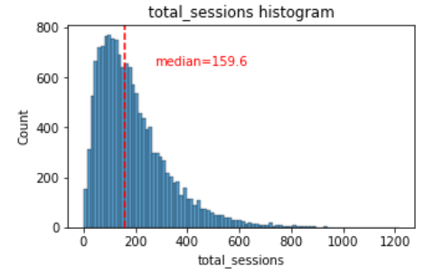
TOTAL Sessions
The distribution of total_sessions is right-skewed, appearing closer to a normal distribution compared to the previous variables.
The median total number of sessions is approximately 159.6.
If the median number of sessions in the last month was 48 and the median total sessions was around 160, it suggests that a significant proportion of a user's overall sessions possibly occurred within the last month.

Slide 7
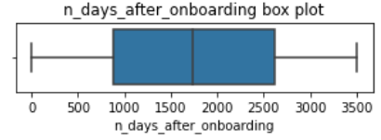
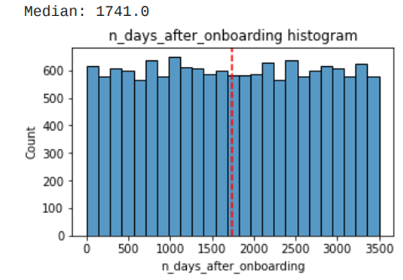
number of Days after onboarding
The total user tenure is a uniform distribution with values rangin from near-zero to ~3500 days, or roughly 9.5 years.
The median number of days since a user signed up for the app is 1741 days, or roughly 4.8 years.

Slide 8
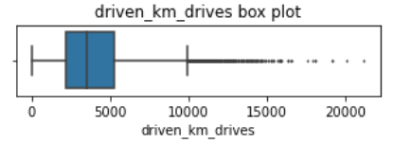
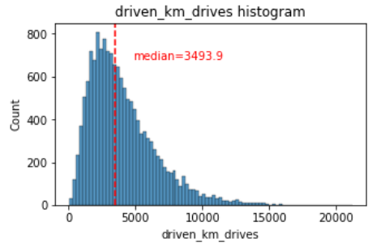
Total KM Driven During the month
The distribution of drives completed by each user in the last month exhibits right-skewed normal distribution.
Roughly 50% of users drove fewer than 3,495 kilometers during that period.
The median number of total kilometers driven during the month 3494 km.

Slide 9
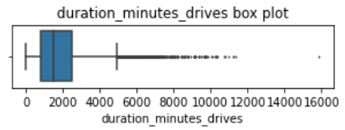
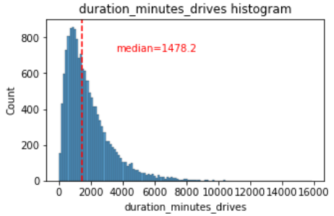
Total Duration Driven During the month
The duration_minutes_drives variable has a normalish distribution with a heavily skewed right tail.
Around 50% of the users had a driving duration of less than the median of 1,478 minutes (equivalent to about 25 hours), while certain users recorded over 250 hours of driving time throughout the month.

Slide 10
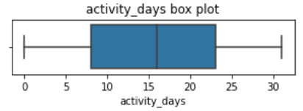
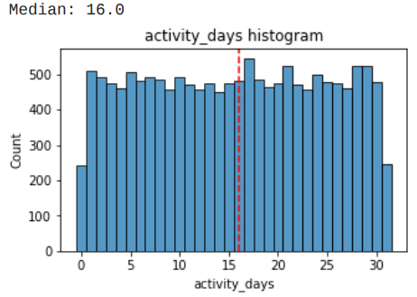
Activity Days
In the past month, users had a median of 16 app openings.
The box plot displays a distribution that is centered.
The histogram indicates a relatively uniform pattern with approximately 500 individuals opening the app on each day.
However, there are approximately 250 users who did not open the app at all, while another 250 users opened it every day throughout the month.

Slide 11
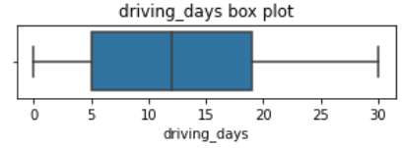
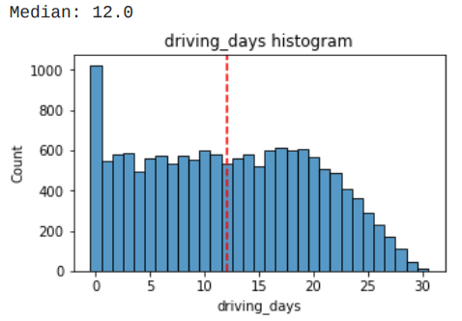
Driving Days
The median number of days the users drove in the last month is 12 days.
The frequency of users driving each month shows a relatively uniform pattern, closely aligned with the number of days they accessed the app within the same period.
The distribution of driving_days skews towards lower values.
Interestingly, there were nearly twice as many users (~1,000 versus ~550) who didn't engage in any driving activity throughout the month..

Slide 12
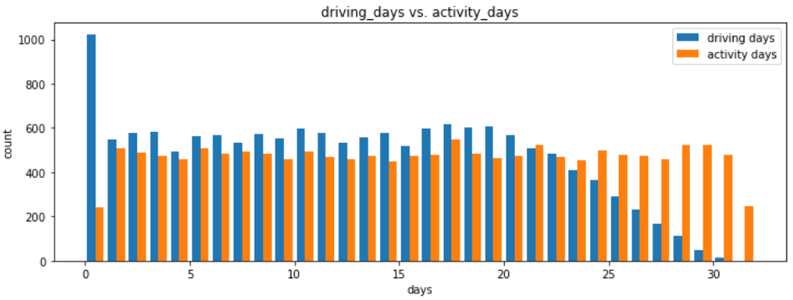
Driving Days vs. Activity days
Initially, more users had an increase in driving_days.
The two variables stayed fairly consistent until around day 21.
After day 21, driving_days steadily declined, while activity_days remained near its previous levels.
This would suggest that though users weren't driving as much, they were still opening and using the app.

Slide 13
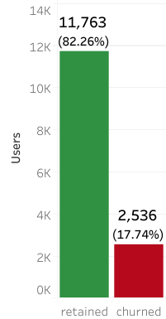
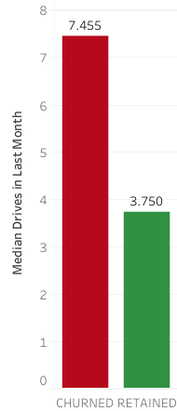
Churn vs. Retained Users
This dataset contains 82% retained users and 18% churned users.
Churned users averaged ~3 more drives in the last month than retained users.

Slide 14
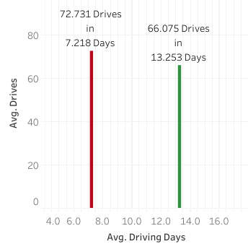
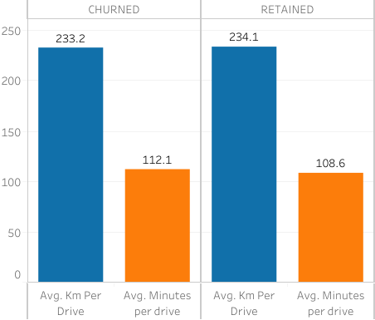
Churned users had more drives in fewer days.
Churned users trips were similar in length but slightly longer in duration. …

Slide 15
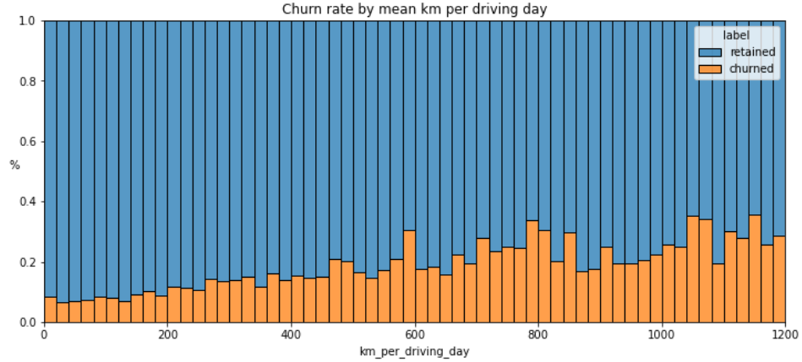
Retention by Km Driven per driving day
As the average daily distance driven increases, the churn rate also tends to rise.

Slide 16
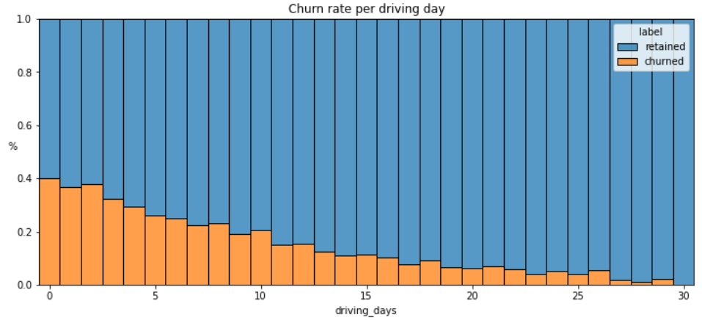
Churn Rate Per Number of Driving Days
The likelihood of churn decreased as the frequency of app usage increased. Among users who did not use the app at all in the last month, 40% churned, whereas none of the users who used the app for 30 days experienced churn.

Slide 17
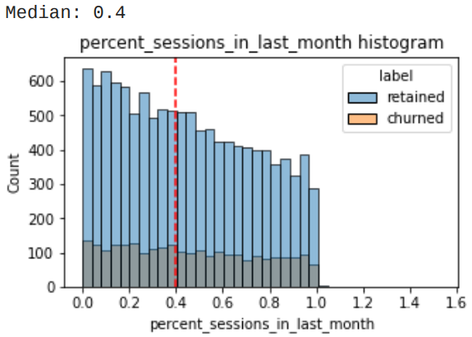
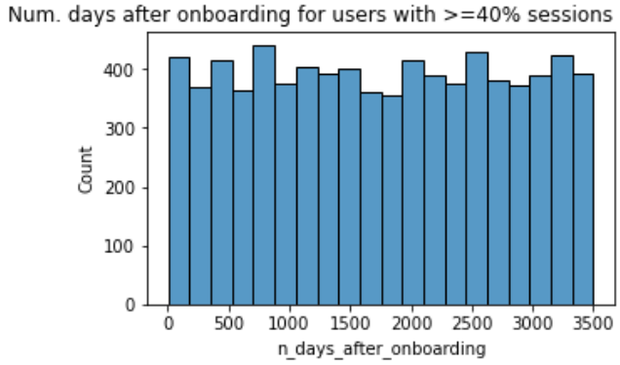
Sessions proportions and Surge in activity for longstanding users
Around half of the users included in the dataset had 40% or more of their sessions concentrated solely in the last month.
The number of days since users onboarded, who have experienced 40% or more of their total sessions within the last month, conforms to a uniform distribution.
Why the sudden surge in app usage by these longstanding users during the recent month?

Slide 18
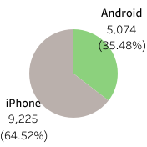
DeviceS: Android vs. iPhone
iPhone devices make up a majority of the users in this dataset.
Android devices account for roughly a third of all users.

Slide 19
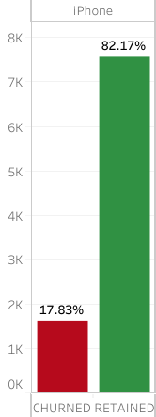
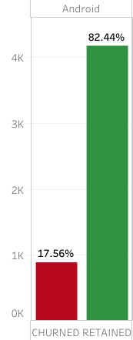
The proportion of iPhone users to Android users remains consistent within both the churned and retained user groups.
There is no indication of any correlation between device type and churn.

Slide 20
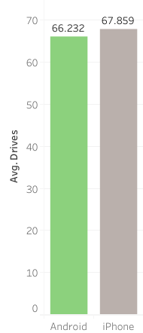
Given the displayed averages, it seems that iPhone device users tend to have a higher average number of drives when using the application.
However, it's important to consider that this disparity may be a result of random sampling rather than an actual difference in the number of drives.
To determine if the distinction is statistically significant, I performed a hypothesis test.

Slide 21
Device Hypothesis testing
Hypotheses:
𝐻0 : There is no difference in average number of drives between drivers who use iPhone devices and drivers who use Androids.
𝐻𝐴 : There is a difference in average number of drives between drivers who use iPhone devices and drivers who use Androids.

Slide 22
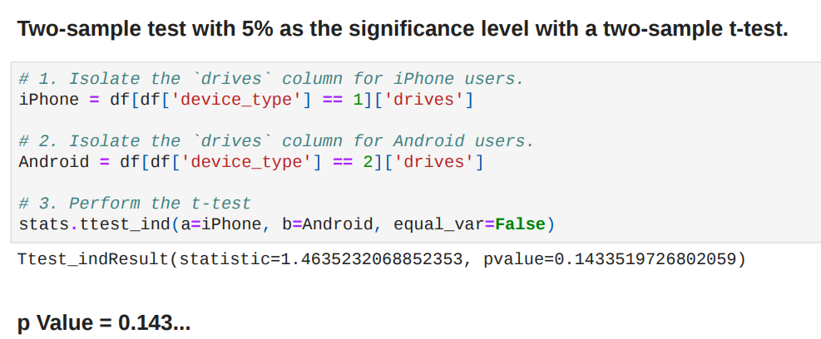
As the p-value exceeds the selected significance level of 5%, we fail to reject the null hypothesis. This indicates that there is no statistically significant distinction in the average number of drives between iPhone users and Android users.

Slide 23
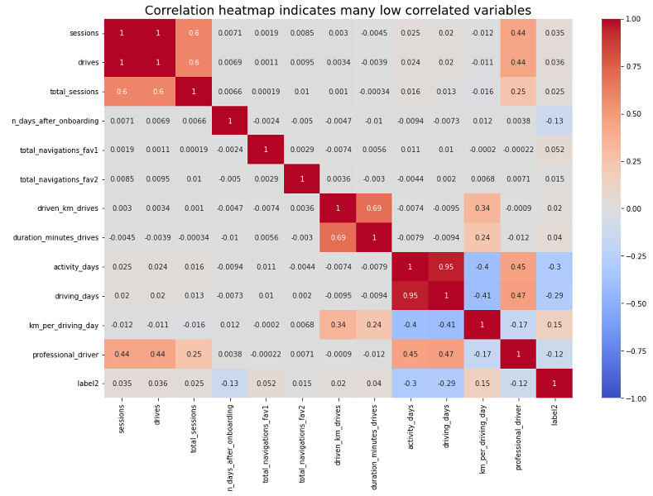
Collinearity
As title suggests, the correlation heatmap indicates many low correlated variables.
Variables that are multicollinear with each other:
sessions and drives: 1.0
driving_days and activity_days: 0.95

Slide 24
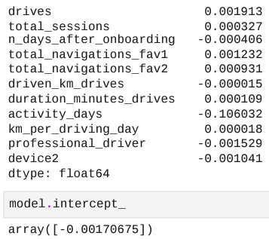
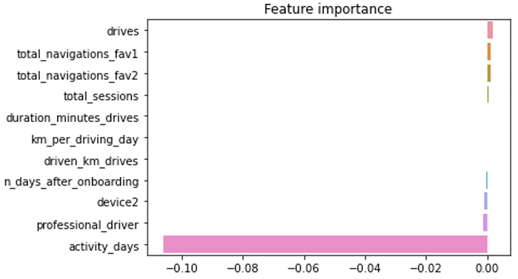
Logistic Regression Model
Among all the features in the model, "activity_days" emerged as the most significant one, exhibiting a negative correlation with user churn.

Slide 25
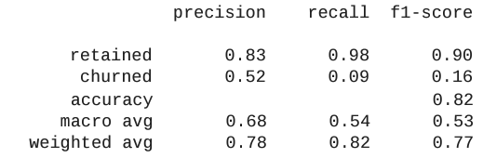
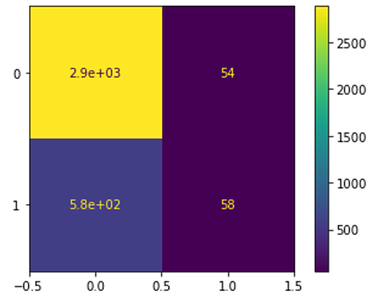

Logistic Regression Model
Although the model demonstrates reasonable precision, its recall is extremely low, indicating a high number of false negative predictions.
Consequently, it fails to identify and capture users who are likely to churn.

Slide 26
Logistic Regression Model insights
“Activity_days" emerged as the most significant feature, exhibiting a negative correlation with user churn.
This finding is not unexpected since "activity_days" is highly correlated with "driving_days," which was already identified to have a negative correlation with churn.
During EDA, the user churn rate rose in conjunction with increasing values in "km_per_driving_day."
The correlation heatmap confirmed this observation, indicating that this variable exhibited the highest positive correlation with churn among all the predictor variables.
Surprisingly, in the model, "km_per_driving_day" ranked as the second-least important variable.

Slide 27
Logistic Regression Model Improvements
By leveraging domain knowledge, it is possible to engineer new features aimed at improving predictive signal.
In the context of this model, one of the engineered features, namely "professional_driver," emerged as the third-most influential predictor.
Scaling the predictor variables and reconstructing the model using different combinations of predictors can be beneficial in minimizing noise stemming from unpromising features.
Possessing drive-level specifics for individual users, such as drive times and geographic locations would be beneficial.
Obtaining more detailed information regarding how users engage with the app would likely provide valuable insights.
Having knowledge of the monthly count of distinct starting and ending locations inputted by each driver could offer valuable additional information.

Slide 28
Logistic Regression Model RECOMMENDATION
The usefulness of the model depends on its intended purpose.
If the model is employed to inform critical business decisions, its performance may not be sufficiently strong, particularly evident from its low recall score.
If the model is primarily utilized to guide further exploratory efforts and provide insights, it can still offer value in that context.

Slide 29
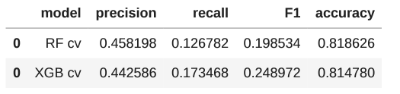
Machine Learning Model randomforest vs. xgboost
The XGBoost model not only outperformed the random forest model in terms of data fitting, but it also achieved a recall score that is nearly twice as high as the recall score obtained by the logistic regression model.
It also demonstrates an improvement of almost 50% in recall compared to the random forest model, while maintaining similar levels of accuracy and precision.

Slide 30
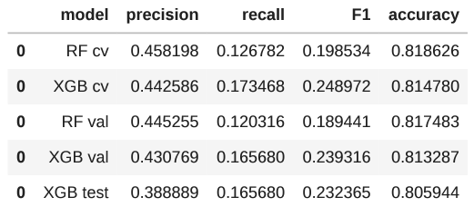
Machine Learning Model Validation and Test
The recall remained unchanged from the validation data, while the precision experienced a significant decline, resulting in a slight drop in all other scores.
Nevertheless, these variations fall within an acceptable range for performance disparities between validation and test scores.

Slide 31
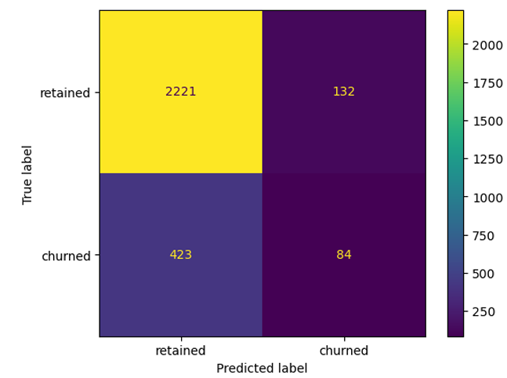
Machine Learning Model Validation and Test
The model's false negatives outnumbered false positives by a factor of three.
It accurately identified only 16.6% of the users who churned.

Slide 32
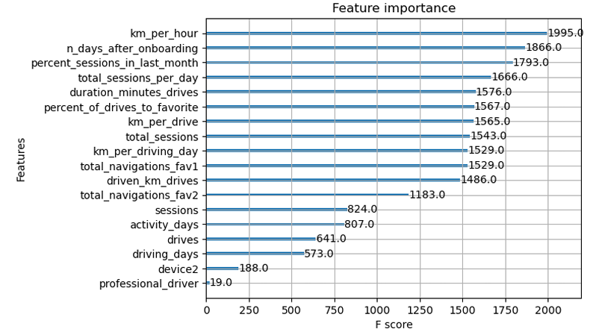
Machine Learning Model Feature Importance

Slide 33
Top Five Most Important Features That Impact Churn:
km_per_hour
n_days_after_onboarding
percent_sessions_in_last_month
total_sessions_per_day
duration_minutes_drives
The XGBoost model utilized a greater number of features compared to the logistic regression model.
Engineered features comprised six out of the top 10 features, including three out of the top five.
It is worth noting that the selection of important features can vary between different models due to the complexity involved in feature selection.

Slide 34
Machine Learning Model Improvements that can be made
Introducing new features could enhance the model's predictive capabilities, particularly with better domain knowledge.
In the case of this model, engineered features accounted for over half of the top 10 most-predictive features employed by the model.
Reconstructing the model using different combinations of predictor variables can help reduce noise originating from non-predictive features.

Slide 35
Machine Learning Model Additional Features That Could Help Improve The Model
Having drive-level information for each user, such as drive times and geographic locations, would be beneficial.
More detailed data providing insights into user interactions with the app would be valuable.
Knowing the monthly count of unique starting and ending locations provided by each driver could offer further assistance.

Slide 36
Final Recommendation
If the model is to be utilized for significant business decisions, then it falls short in being an ideal predictor, as evidenced by its low recall score.
If the model is solely employed to guide exploratory efforts, it can provide value.
The model could be more predictive if we gather more drive level data as mentioned previously, as well as exploring different engineered features.

